Slide 1
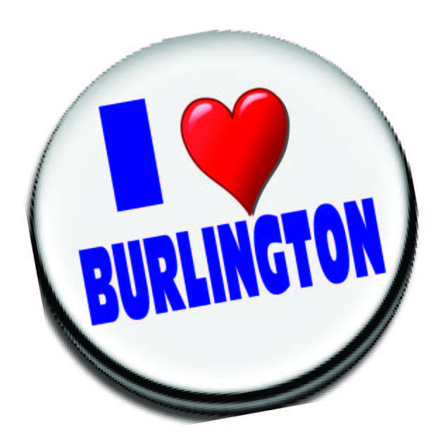
C.O.N.N.E.C.T. MINISTRIES PRESENTS
“WHERE WE LIVE WORK, WORSHIP AND PLAY!”

Slide 2
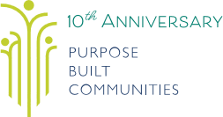
A Holistic Model for the Burlington Community

Slide 3
Purpose Built Communities purposebuiltcommunities.org
Changing Neighborhoods, Changing Lives
Imagine breaking the cycle of intergenerational poverty. The Purpose Built vision guides neighborhood revitalization by creating pathways out of poverty for the lowest-income residents, and building strong, economically diverse communities.
Cross-sector collaboration isn’t merely an option but a necessity to create neighborhoods where everyone can thrive...Purpose Built Communities is helping leaders around the country use the model developed in East Lake to build healthy, sustainable neighborhoods with pathways to prosperity for the lowest income families.
Carol Naughton, President, Purpose Built Communities

Slide 4
Purpose Built Communities
was established in 2009
after the successful transformation of the East Lake neighborhood in Atlanta. By applying the holistic model to other areas of concentrated urban poverty around the nation, Purpose Built Communities is helping local leaders make a positive impact in some of this country’s most distressed neighborhoods. We have a growing network of a dozen members leading comprehensive revitalization initiatives, and we are only just beginning.

Slide 5
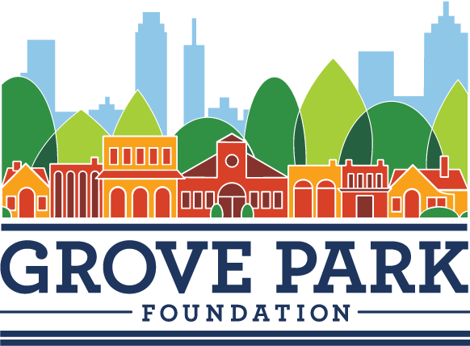
The foundation is dedicated to revitalizing the Grove Park neighborhood and improving the quality of life by working with local partners, leaders and residents to create a healthy, equitable and vibrant community.
Debra Edelson
Executive Director
Grove Park Foundation
1314 Donald Lee Hollowell Parkway NW
Atlanta, GA 30318
dedelson@groveparkfoundation.org
https://groveparkfoundation.org/
Over the past few years, Debra and her team have been heavily engaged and involved in the Grove Park neighborhood. We are already seeing results with the coming investments in a new, high-quality public school and a YMCA, and this is just the beginning.
Karen Rose
President
Grove Park Neighborhood Association

Slide 6
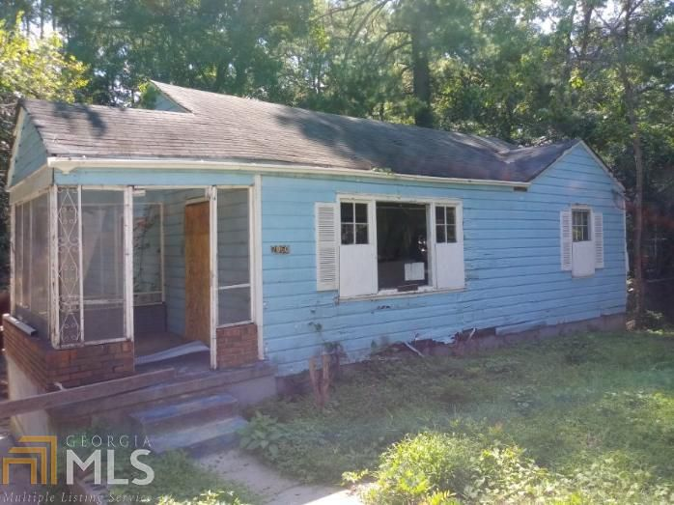
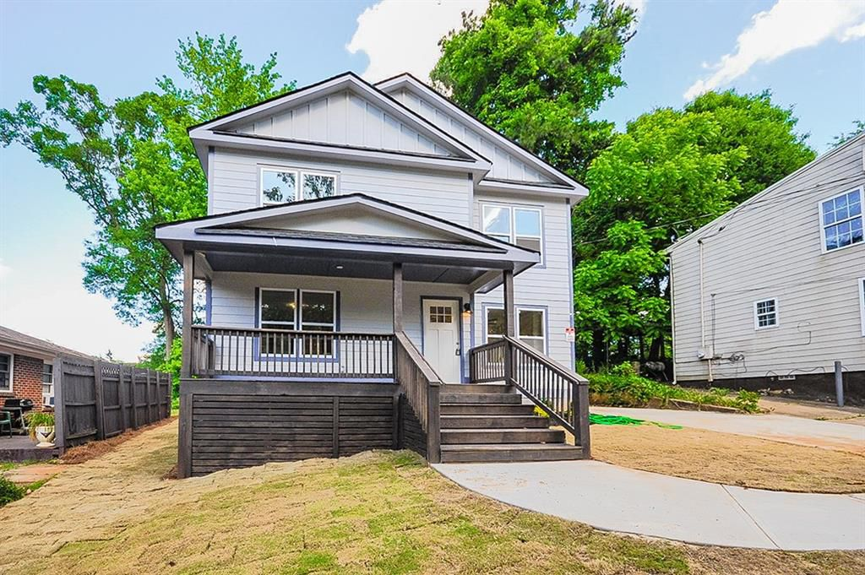
GROVE PARK PROJECT ATLANTA, GA

Slide 7
Getting CONNECTED
MAKING A LASTING IMPACT
To cultivate a new future for East Lake, we are working with the community and our partners, implementing a vision of holistic community revitalization that will put an end to a cycle of generational poverty. Among our milestones already achieved:
Secured $18.5 million in funding from Atlanta Public Schools for construction of a new Woodson Park Academy, K–8 school building slated to open in 2020
Successfully advocated for the approval of KIPP schools as the designated operator of Woodson Park Academy, beginning in August 2019
Secured partnership with the YMCA of Metro Atlanta to construct a new state-of-the-art community wellness and early childhood learning center adjacent to Woodson Park Academy
Building a partnership with Callanwolde Fine Arts Center to provide arts experiences for all of Grove Park’s K-5 students
Connected Grove Park residents and organizations with Atlanta Volunteer Lawyer’s Foundation to provide pro-bono legal advice and representation around landlord/tenant disputes, evictions, unpaid wages, domestic violence, and probate issues
Linked Soccer in the Streets to the Grove Park neighborhood, bringing soccer and character building programming to Grove Park’s children

Slide 8
C.O.N.N.E.C.T. Ministries Building Community
COMMUNITY BUILDING
Grove Park Foundation is engaging with residents to bring about neighborhood stabilization and revitalization. We continue to learn and understand the needs and challenges shaping the local neighborhood landscape. We have taken several important steps that are already resonating with the community, and we are eager to move forward with additional programs. Through this process, we are helping foster a healthy environment for new opportunities, and developing partnerships with local business and community leaders to implement the vision and set a new course in Grove Park.

Slide 9
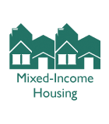

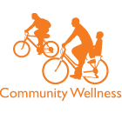
100 mixed-income, family housing proposed
$18.5 million Commitment from Atlanta Public Schools (APS) to help construct Woodson Park Academy,
a K-8 neighborhood school building slated to open in 2020
$35 million Fundraising campaign for construction of the new Woodson Park Academy
and an adjacent new state-of-the-art YMCA / community wellness center leveraging APS' investment
Grove Park

Slide 10
MILLIONS OF AMERICANS IN NEED
More than 43 million Americans, and 1 in 5 children live in poverty. However, focusing solely on those in poverty does not account for all low-income Americans. Another 57.8 million Americans are considered low-income, which means they are living at or above the poverty threshold, but below 2 times poverty. We are committed to turning these numbers around.
TEAMING TOGETHER FOR CHANGE
The proverb, “it takes a village” could not be more truly applied than in the environment of urban revitalization initiatives. It is a monumental endeavor to implement holistic change in disadvantaged communities, and it requires expertise from all walks of life. Purpose Built Communities has brought together some of the brightest minds to seek out meaningful change in our neighborhoods and cities.
Purpose Built Communities is an assemblage of internationally recognized leaders of business, a former Mayor of Atlanta, policy makers, philanthropists, community quarterbacks, directors of nonprofits, developers, education experts, finance and asset managers, grant writers, affordable housing directors, real estate executives, corporate officers, community planners, attorneys, consultants, and much more. This “dream team” of innovative thinkers is driven by a collective desire to transform communities, improve the lives of residents of underserved neighborhoods, end a cycle of intergenerational poverty, and set a new course for cities across the country.

Slide 11



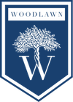
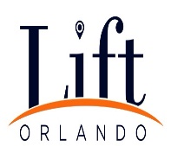
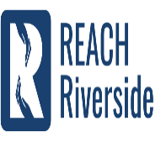
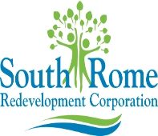


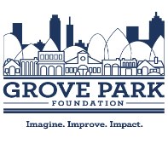
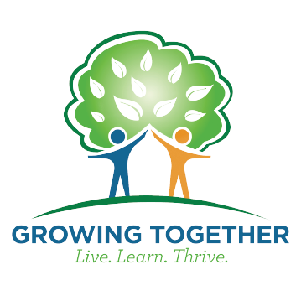


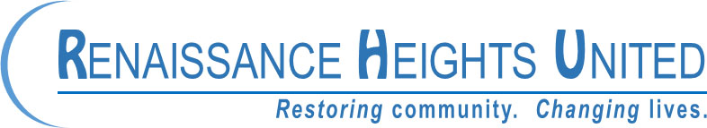

Slide 12
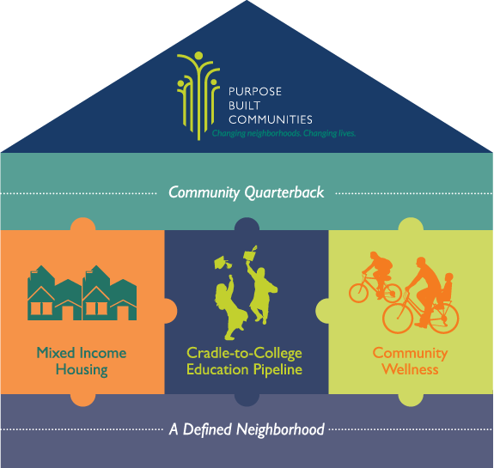
“The Burlington village”

Slide 13
DEFINED NEIGHBORHOOD
Focus on defined neighborhoods where transformative programs and infrastructure can be established; if we can change the place, we can change outcomes for the people who live there.
COMMUNITY QUARTERBACK
Usually a newly-created nonprofit, it leads the revitalization by engaging community members, building partnerships, securing funding, and ensuring implementation of the housing, education, and wellness components of the model as part of the community’s vision.
MIXED-INCOME HOUSING
Offer an environment with high-quality construction and practical amenities surrounded by safe walkways and streets, transforming the way residents view themselves and their neighborhood.
CRADLE-TO-COLLEGE EDUCATION
Establish an arena for student growth, learning, and achievement at every level starting at birth, and implement a rigorous and relevant curriculum to help ensure successful futures through college and beyond.
COMMUNITY WELLNESS
Provide a community-specific mix of facilities, programs, and services that honor local history, reflect the priorities of residents, promote healthy lifestyles, create jobs, and reduce crime.
Holistic approach, proven model

Slide 14
“THE BURLINGTON FOUNDATION”
“Where We Live, Work, Worship and Play.”

